Slide 1


Web Development Internship Summary
Naman Sharma, CSE 3rd year, Student ID: 2200290100107
Projects: To-Do List & Calculator
by Naman Sharma

Slide 2

Internship Overview
1
Objective
Enhance web development skills through hands-on projects
2
Focus
Practical application of coding concepts
3
Duration
Intensive learning experience over several weeks

Slide 3





Skills & Technologies Learned
HTML
Structure and content of web pages
CSS
Styling and layout of web pages
JavaScript
Interactive and dynamic web functionality
Debugging
Identifying and fixing code issues

Slide 4
Project 1 – To-Do List App
Purpose
Features
Design
Efficient task management tool
Add, view, and delete tasks easily
User-friendly interface with responsive layout

Slide 5
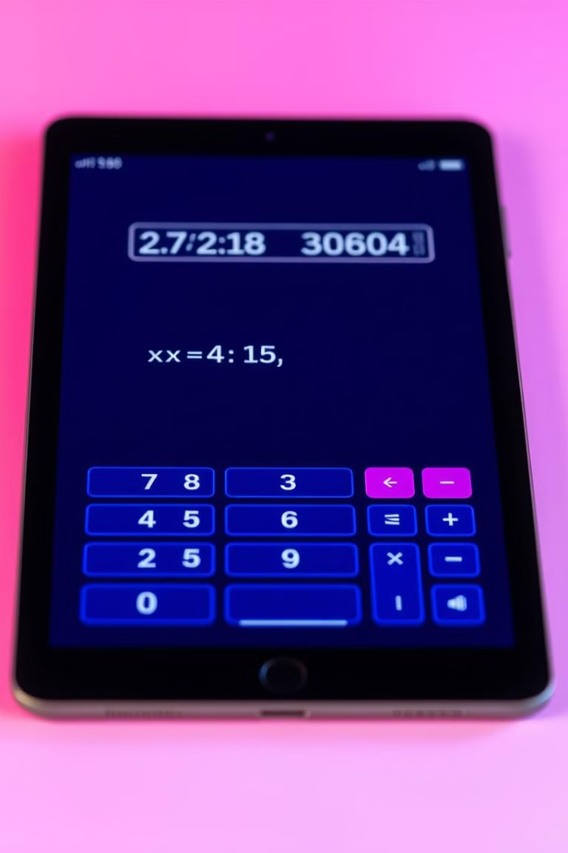
Project 2 – Calculator App
Purpose
Perform basic arithmetic operations
Features
Real-time calculations with error handling
Design
Intuitive UI for easy number input
Functionality
Accurate results for various mathematical operations

Slide 6




Key Challenges Faced
DOM Manipulation
Dynamically updating task list in To-Do app
Event Handling
Managing user interactions in both projects
Responsive Design
Ensuring compatibility across various screen sizes

Slide 7

Key Takeaways
Skill Improvement
1
Enhanced JavaScript proficiency and coding confidence
2
UI/UX Understanding
Gained insights into user-centric design principles
Problem-Solving
3
Developed analytical approach to coding challenges

Slide 8

Conclusion
Experience Gained
Hands-on web development skills
Future Plans
Tackle complex projects, expand knowledge
Career Impact
Solid foundation for web development career

